Slide 1
Presentation on phonetical symbols
Presented by
Prof. Imtiaz Ahmad wani
Department of Engish
Govt. P.G College Rajouri.

Slide 2
Phonetics
The study of physical properties of sound
Sounds may not be represented systematically by spelling.

Slide 3
Why not just spell?
Sounds may not be represented systematically by spelling because...
Same spelling for different sounds
Combination of letters representing one sound,
Some letters are silent

Slide 4
Phonetic Alphabet
One symbol represents one sound
Each speech sound has a distinct symbol
Cross-linguistically applicable

Slide 5
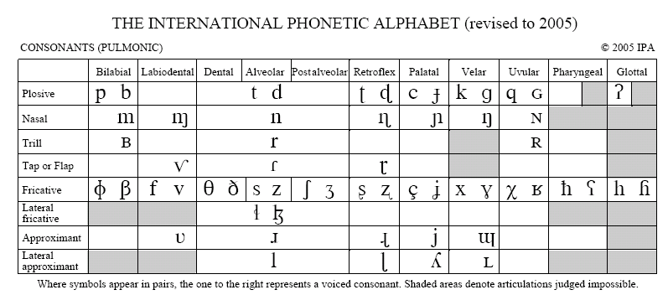
IPA

Slide 6
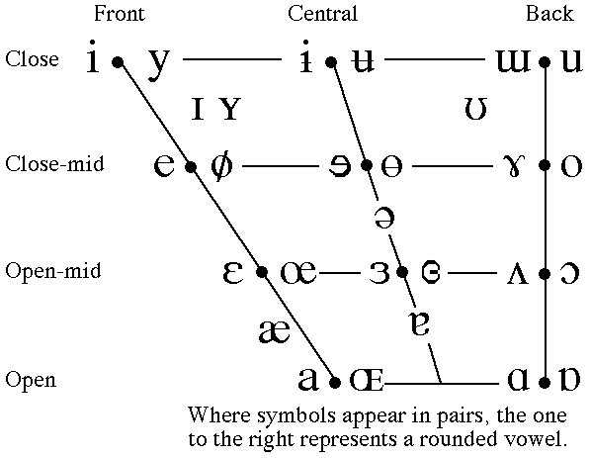
Vowel Sounds

Slide 7
[p]= pat
[b]= bat
[t]= tap
[d]=dam
[k]= car
[g]=guard
[f]= foot
[v]= van
[h]= hat
[m]=mull
[n]= null
[ŋ]= ring

Slide 8
[ɹ]= ring
[l]= leaf
[j] = yes
[w]= with
[ʃ]= shine
[ʒ] = vision
[ʧ]= touch
[ʤ]= judge
[s] = sap
[z] = zip
[θ] = think
[ð] = this

Slide 9
Diphthongs (Complex Vowels)
Complex because they are two-part vowels
But count as a single sound because two vowels are articulated together. Examples:
[ɑɪ] =bite
[ɔɪ] = boy
[eɪ]= bait

Slide 10
Practice
next chin lamb
kite cat meet

Slide 11
Manners of articulation
Stops [p] [b] [t] [d] [k] [g]
Fricatives [f] [v] [θ] [ð] [s] [z] [ʃ] [ʒ]
Affricates [ʧ] [ʤ]
Liquids [l] [ɹ]
Glides [w] [j]

Slide 12
Thank you

